Slide 1

Seasonal Agriculture Performance Analysis
Piyush Kumar
Galgotias College of Engineering and Technology
AICTE STU ID : STU6763bbd81644a1734589400

Slide 2

PROBLEM STATEMENT
Agricultural performance is influenced by seasonal environmental conditions, farming practices, resource availability, and market conditions.
These factors can cause agricultural outcomes to vary across different seasons.
Raw agricultural data does not clearly reveal seasonal patterns, trends, and variations.
The objective is to analyze the agricultural dataset and compare performance across different seasons.
The analysis aims to identify meaningful patterns, relationships, trends, and seasonal differences in agricultural performance.
These insights can help in understanding how seasonal conditions affect agricultural productivity and outcomes.

Slide 3
1. Analyzed 4,000 farm-level agricultural records. 2. Dataset covers 8 states, 10 districts, 8 crops, and 3 cropping seasons — Kharif, Rabi, and Zaid. 3. Used Python with Pandas, Matplotlib, Seaborn, and SciPy for data analysis. 4. Performed data cleaning using: Season-wise imputation IQR-based outlier capping 5. Analyzed seasonal variations in: Crop Yield Profitability Water-Use Efficiency Disease and Pest Risk 6. Applied ANOVA testing to validate the significance of seasonal differences. 7. Developed evidence-based recommendations for effective seasonal agricultural planning.
PROJECT DESCRIPTION

Slide 4

WHO ARE THE END USERS?
Farmers & farmer cooperatives — to choose crops/irrigation methods suited to each season
State agriculture departments & extension officers — for evidence-based seasonal planning
Agri-input and irrigation companies — to target drip-irrigation adoption in water-scarce seasons
Agricultural economists & researchers — to study seasonal drivers of yield and profitability
Crop insurance & financial institutions — to assess seasonal risk (e.g. Zaid loss patterns)
Policy makers — to design subsidies/support programs tailored to season-specific challenges

Slide 5

TECHNOLOGY USED
Python 3 — core programming language for the analysis
Pandas & NumPy — data cleaning, transformation and aggregation
Matplotlib & Seaborn — statistical data visualization
SciPy (stats) — ANOVA significance testing
Jupyter Notebook (executed via VS Code) — end-to-end documented analysis workflow
Git & GitHub — version control and project submission

Slide 6
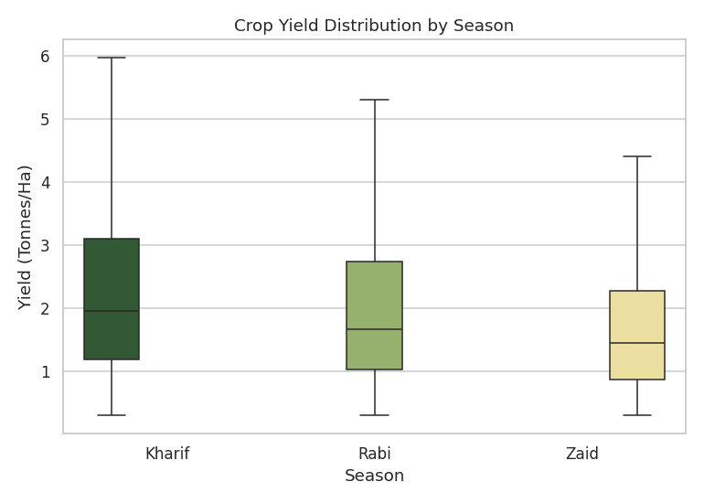
RESULTS
Kharif shows the highest average yield, Zaid the lowest.

Slide 7
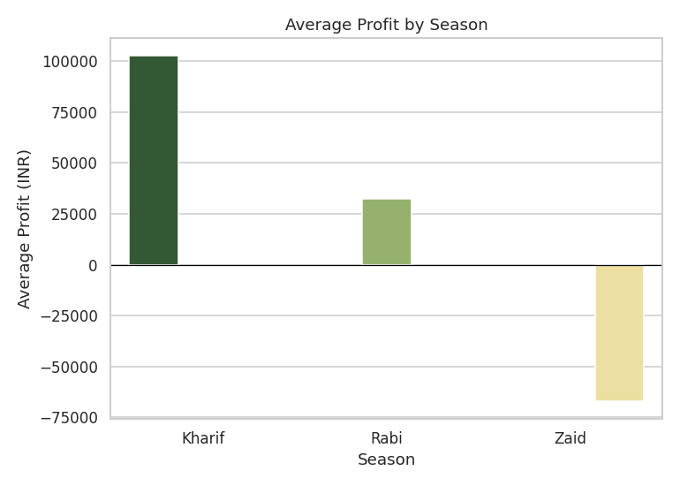
RESULTS
Kharif is the most profitable season; Zaid runs a loss on average.

Slide 8
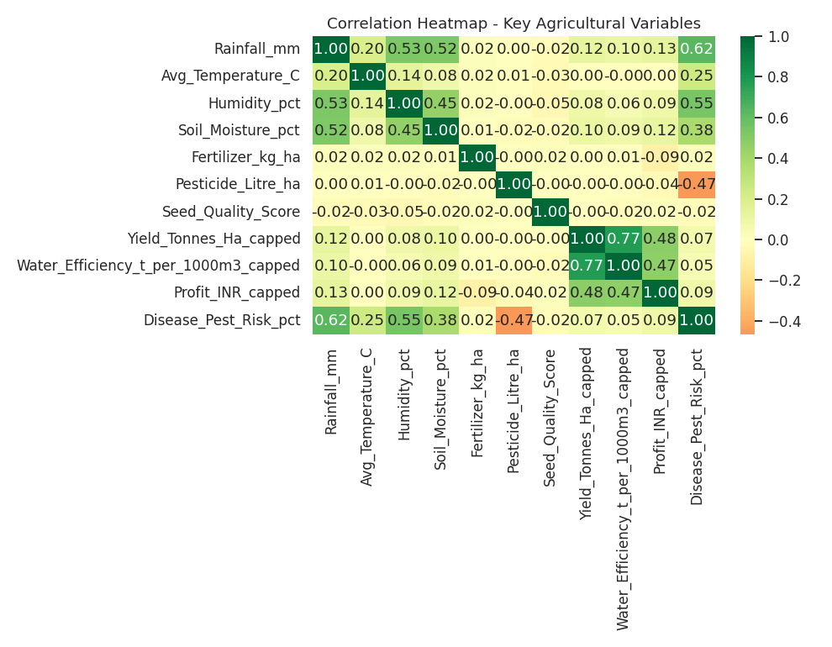
RESULTS
Water-use efficiency (r ~ 0.77) is the strongest driver of yield.

Slide 9
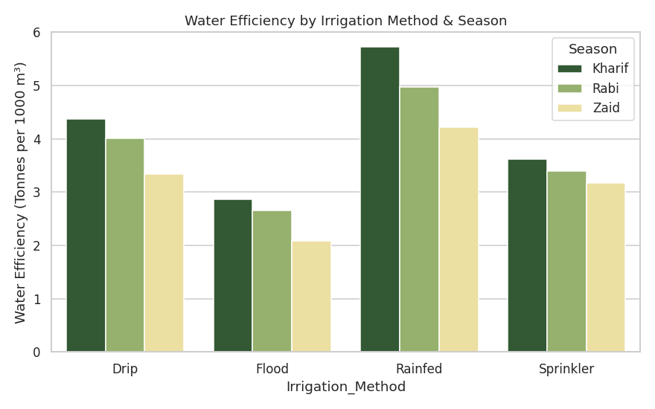
RESULTS
Drip irrigation is the most water-efficient method in every season.

Slide 10
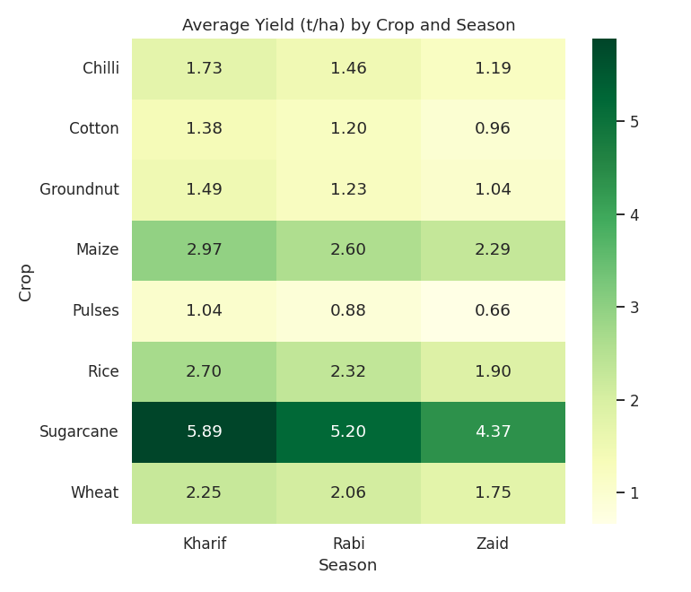
RESULTS
Kharif > Rabi > Zaid yield ordering holds across all 8 crops.

Slide 11
FUTURE SCOPE
• Extend to multi-year time-series data to capture year-on-year seasonal trends
• Build a regression/ML model to quantify each factor's marginal effect on yield & profit
• Develop a seasonal crop & irrigation-method recommendation system for farmers
• Incorporate satellite/weather-forecast data for proactive seasonal planning
• Extend coverage to more states/districts to improve generalizability
• Create an interactive dashboard for real-time seasonal performance monitoring

Slide 12
GITHUB LINK
https://github.com/PiyushKumar9341/Seasonal-Agriculture-Performance-Analysis

Slide 13

VOIS Course completion certificate - Course name- Data Visualization

Slide 14
THANK YOU

